Slide 1
Customer Meeting
Feb 24

Slide 2
Agenda
Our original goals for the last iteration
Our progress
Delivery Plan
Demo
Issues we had
Missed objectives
Supplementary Goals
Next iteration goals and Risk

Slide 3
Original Goals for Iteration 5 (Jan 20 –Feb 24)
Complete Population Script (Medium Risk)​
Finishing static HTML/CSS pages (minor) (Low Risk)​
Implementing test coverage (Medium Risk)​
User consent form (T&C and Privacy Policy) (Low Risk)​
Create a generic report (output) component in a web client which would display results from the backend (High Risk)​
Create submission form (can be depersonalized - for HR) (High Risk)​
Login/Logout functionality + forgot password (email) (Low Risk)​

Slide 4
Our progress
Complete Population Script (Medium Risk)​
Finishing static HTML/CSS pages (minor) (Low Risk)
User consent form (T&C and Privacy Policy) (Low Risk)
Create a generic report (output) component in a web client which would display results from the backend (High Risk) ​​
Create submission form (can be depersonalized - for HR) (High Risk)
Login/Logout functionality + forgot password (email) (Low Risk)

Slide 5
Delivery Plan
MVP Completed
Create a generic report (output) component in a web client which would display results from the backend (High Risk) ​​
Create submission form (can be depersonalized - for HR) (High Risk)
Login/Logout functionality + forgot password (email) (Low Risk)
Product Deployment – PythonAnywhere
Free and publicly accessible
Not bound to ViloSky website
Allows for testing and linking at a later stage

Slide 6
Demo of Input/Output function

Slide 7
Issues we had
Change in input form to support more reliable output report
Cause
Impact
Solution

Slide 8
Missed Objectives
Implementing Test Cases
Cause
Impact
Solution

Slide 9
Supplementary Goals
Profile page
Generic list component

Slide 10
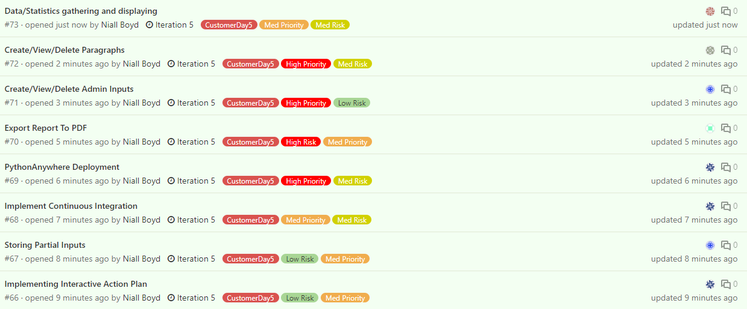
Next iteration goals & Risk

